Slide 1

IR From a Different Perspective
Social Engineering Your Way to Trust
FajitaCon2020
May 2nd, 2020

Slide 2
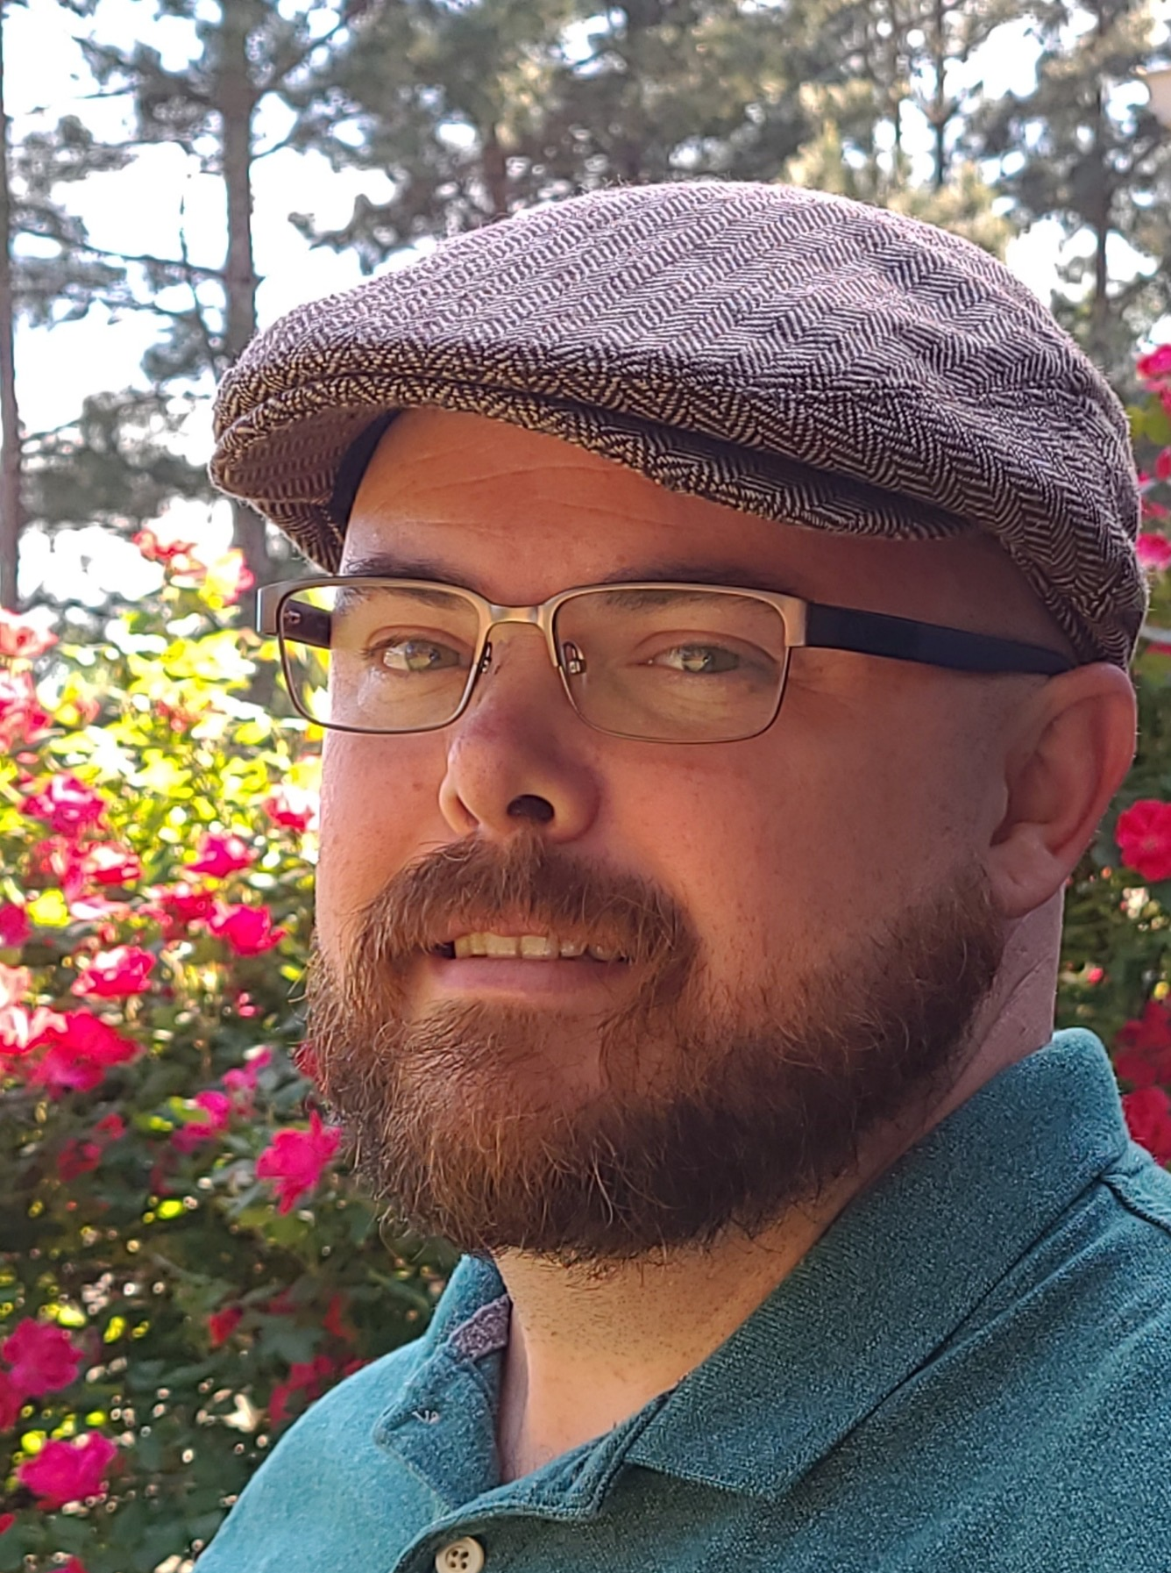
ABOUT ME
Rob Morrow –
Network Engineer/Incident Response
I am a Network Engineer with a strong focus on Security, and an Incident Responder. I have training in Ethical Hacking, Incident Response, and Security Operations as well as a strong base in Networking and Information Technology.
I did not start out in IT but found my calling after an organization I worked for experienced a cyberattack. I have worked in multiple industries over the past 20 years, and my diverse background has allowed me to look at both IT and Incident Response through a unique lens.
In my free time, I enjoy spending time with my family and many outdoor activities. I am also an active participant in Security Capture the Flag competitions and I recently started a blog to document my foray into incident response.

Slide 3
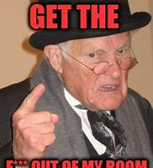
Incident Response
Traditional Aspects of Incident Response
Containment, containment, containment!!!
Eradication of malicious element.
Forensics

Slide 4
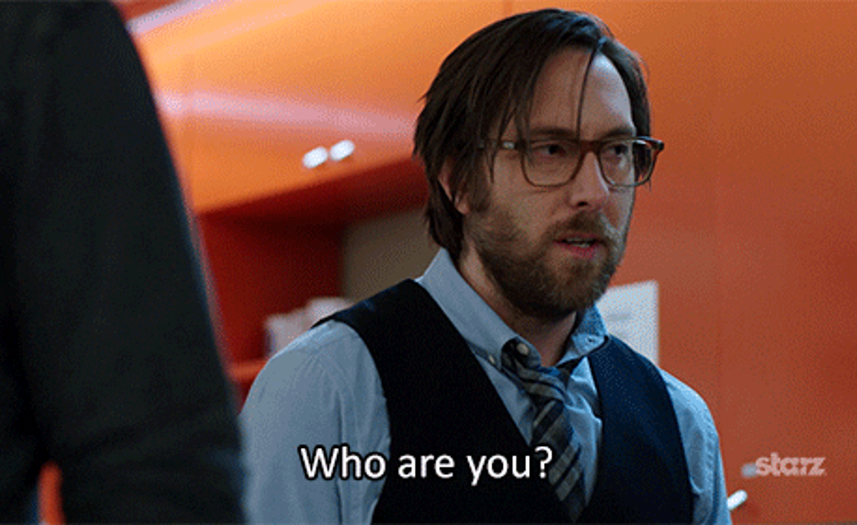
Reconnaissance
Who are you, and what am I doing here?
Introduce yourself to staff not just the management.
Try to find out the level of hell you just walked into.
Work to obtain a base understanding of scope.
Start looking for targets.
Realize that they need your help, yes, but you also need their help.

Slide 5




Scanning
Looking for the Initial Point of Access
Find a Person
Find a team member that you can build a connection with.
Grow that relationship
Get to know as much as you can about the person in a short time. You will need it.
Build the Trust
Use what you have learned about the person to increase the level of trust between you.
Set the Hook
Congratulations, you just got your initial foothold in the system.

Slide 6
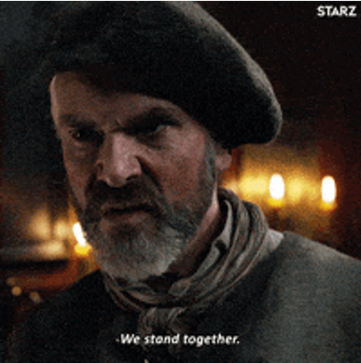
Gaining Access
Building Trust with the Team
The Game of Lateral Movement and Privilege Escalation
Make friends and lots of them.
Remember that they are all terrified. I mean really terrified.
Coffee and Donuts go a long way. Do things to help them see you as a friend.
The more trust you build, the more access you have.
Help with things that aren’t necessarily important to you, they can be important to the team.
You will have to prove yourself.
Work with the person who thinks they are going to take the blame. There is probably a reason.

Slide 7
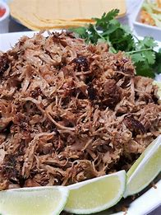
Carnitas Break
1 teaspoon salt
1 teaspoon garlic powder
1 teaspoon ground cumin
½ teaspoon crumbled dried oregano
½ teaspoon ground coriander
¼ teaspoon ground cinnamon
1 (4 pound) boneless pork shoulder roast
2 bay leaves
2 cups chicken broth

Slide 8
Maintaining Access
Getting friendly with the C-Levels
1
2
3
Shmoozing and Boozing
Taking the Talk
Walking the Walk
Be Personable
You will go out to dinner
Just be comfortable
Don’t sugarcoat it
Be sympathetic
Good news FIRST
Do what you do best
Be confident
Your job comes first

Slide 9

Clearing Tracks
Time to go the f*** home
Time to get out of there
Make sure they are in a place they can function
Be available, but not too available
It should start feeling like you are needed less and less
Maintain friendships
This Photo by Unknown Author is licensed under CC BY-NC-ND

Slide 10
THANK YOU!
Rob Morrow
Twitter:
@lfslstlbrty
Email:
lfslstlbrty@protonmail.com
Website:
http://www.medium.com/lfslstlbrty

